Slide 1




The History of Water
Fluoridation
Md. Shaddam Hossain Bagmar
2019
*Updated version of Shuo Sun (2018) presentation slides

Slide 2
Outline
Introduction
  Beneficial and harmful effects of fluoridation
  Confusions and challenges
Observational studies
Observation after intervention
  Findings in favor of fluoridation
  Findings against fluoridation
Debate: fluoridation versus no fluoridation
Concluding remarks

Slide 3
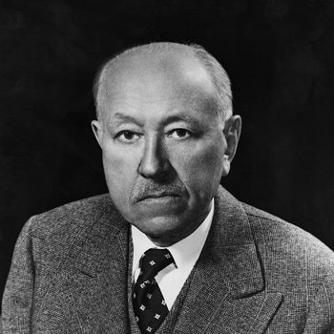
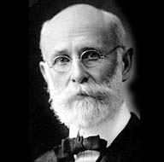
Introduction
Begin in 1901, McKay gave systematic attention to the mottling and brown stain (fluorosis) he found on the teeth of many of his patients in Colorado
By 1909 McKay and his colleague Dr. G. V. Black studied several cases and identified the water supply as the factor behind dental fluorosis.
Notes:
I am not a big fan of having full sentences in ppt. If you do put full sentences, people may try to read them rather than listen to you, especially if your accent is harder to follow. So better to put pharse that REMIND you what you want to say in sentences, and also give the reading-only audience the key words
So here I would just have
U.S. dentist Frederick S. McKay (1874–1959) and
Fluorosis
BTW you didn’t read carefully your own words,, It should be Beginning
1909 McKay and colleague Dr. G. V. Black studied several cases and identified the water supply as the factor behind dental fluorosis.
Also have you though about using animation, so readers don’t read ahead. Animation lets YOU control the flow.

Slide 4
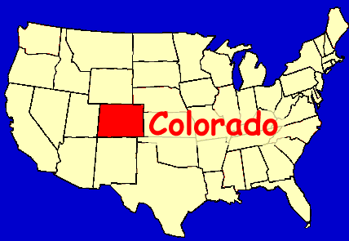
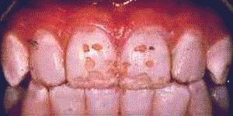
At that time, analysis of water with small quantities of fluoride had not been perfected and the etiologic agent was not identified till more than two decades later.
In 1928 studies in Bauxite, Arkansas, led to the final discovery that fluorosis was associated with fluoride in water (Harmful effect).
In 1930s, Dr. H. Trendley Dean found: adding fluoride to drinking water at safe levels would help fight tooth decay. (Beneficial effect)

Slide 5

Confusions?
Is fluoridation effective?
Is fluoridation cost effective?
Is fluoridation safe?

Slide 6
Challenges
we can not control how much people drink?
also can not pick and choose which people to exclude from the treatment.
maintaining a certain level of fluoride in the water which is safe.

Slide 7

Unfolded stories about fluoridation:
Harmful effects of fluoride in large doses
Dental benefits from small doses
What will be the safe dose in water???

Slide 8
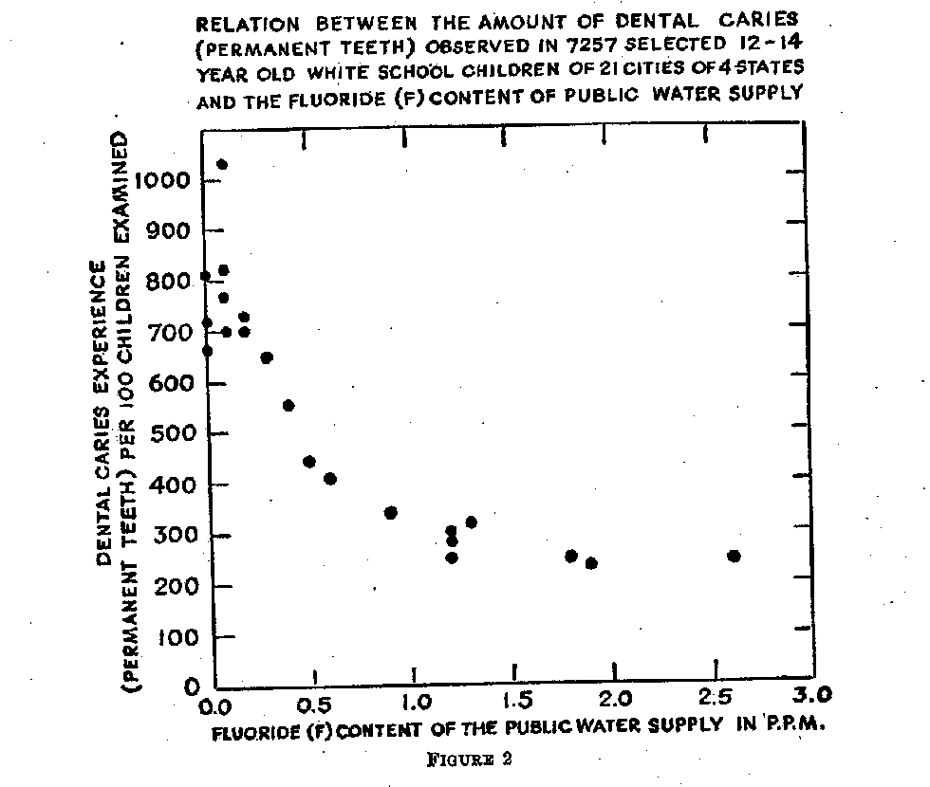
Observational Studies

Slide 9
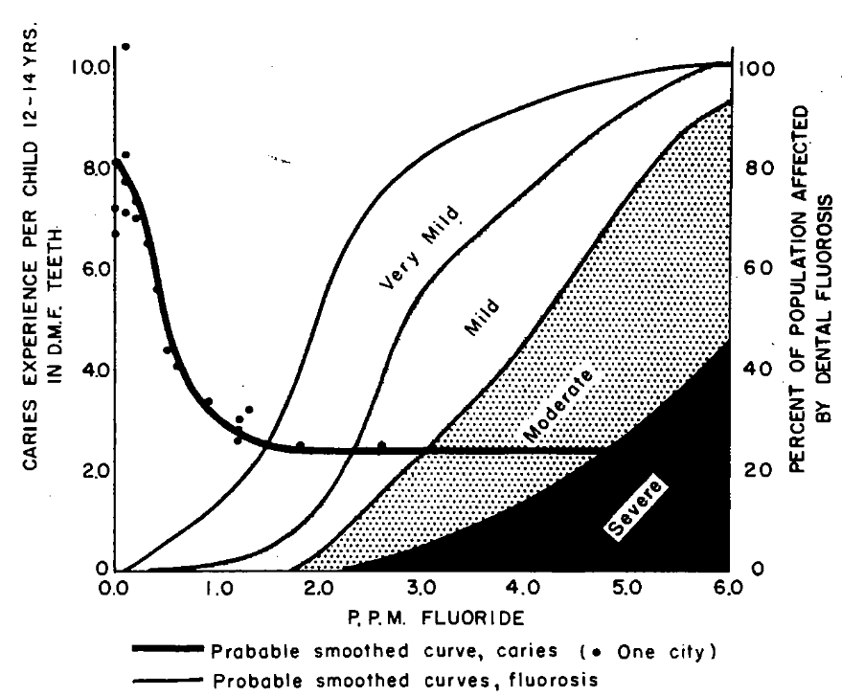
Observational studies
safe dose

Slide 10
Observation after intervention
Newburgh and Kingston studies
The Kilmarnock Studies

Slide 11
Newburgh and Kingston studies
The study was started in 1945 in Newburgh and Kingston two cities in New York
Newburgh added fluoride to its drinking water and Kingston was selected to be comparison population.
They measured the dental quality based on the number of decayed, missing or filled teeth (DMF).

Slide 12
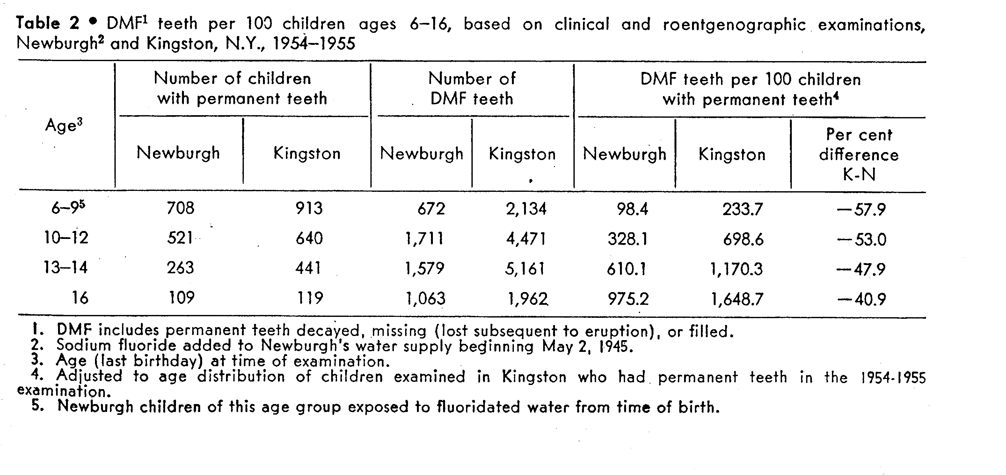



























































Slide 13
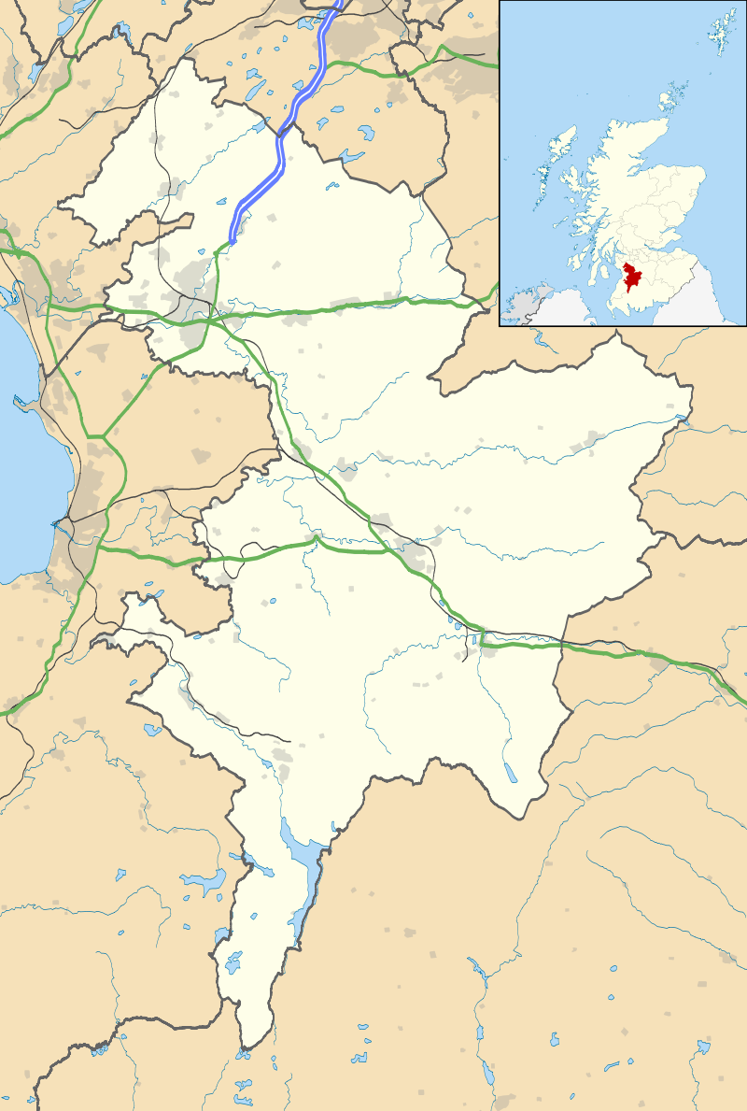
The Kilmarnock Studies
Fluoridation began in April 1956, ceased in October 1962
Samples of children in age range 3-14 were examined annually in Kilmarnock (treatment) with comparable samples in Ayr (control)
it was an unusual and valuable opportunity to get more information about the fluoridation effect
We can divide the time period in the study area as: pre-fluoridation (<1956), with fluoridation (1956-1962), post-fluoridation (>=1963)

Slide 14
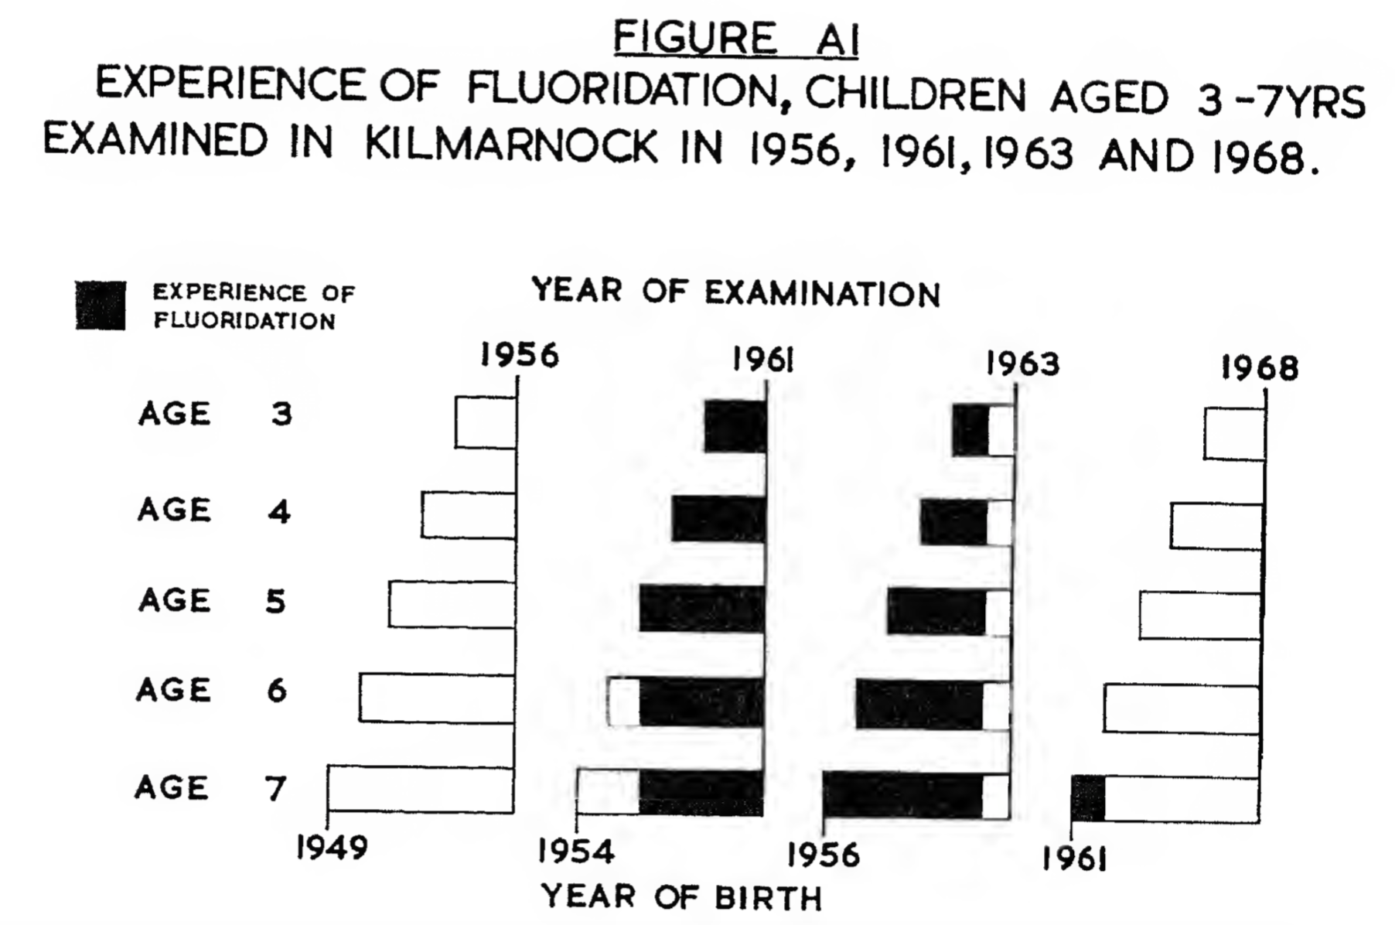
The Kilmarnock Studies

Slide 15
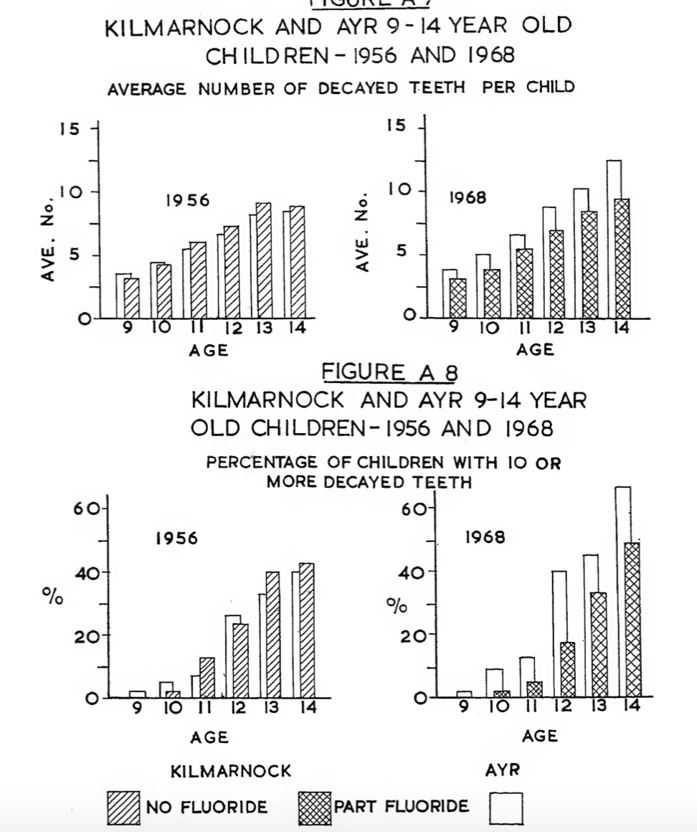
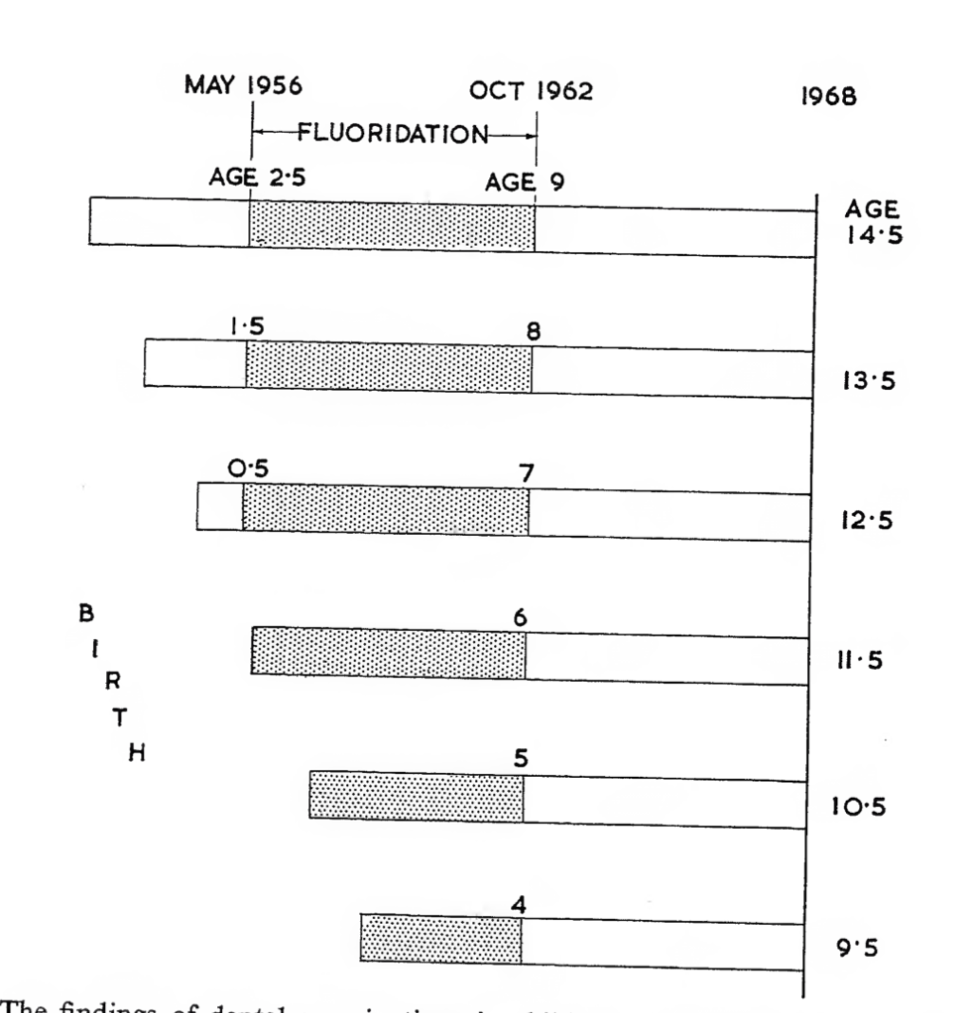
The Kilmarnock Studies
(permanent teeth)

Slide 16
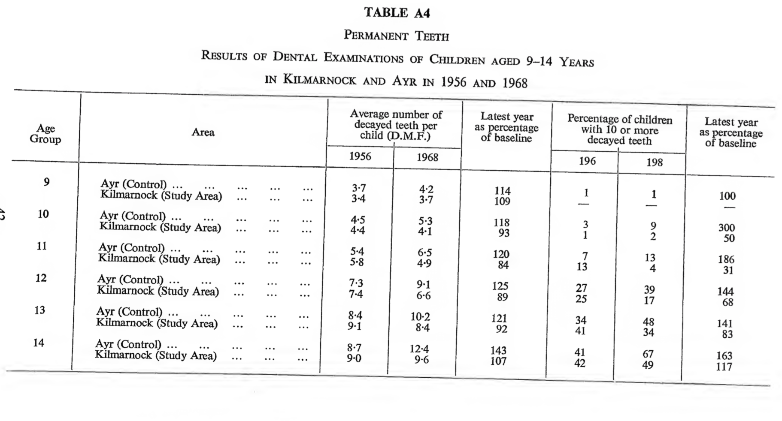




































The Kilmarnock Studies
(permanent teeth)

Slide 17

And since then…

Slide 18
Findings in favor of fluoridation

Slide 19
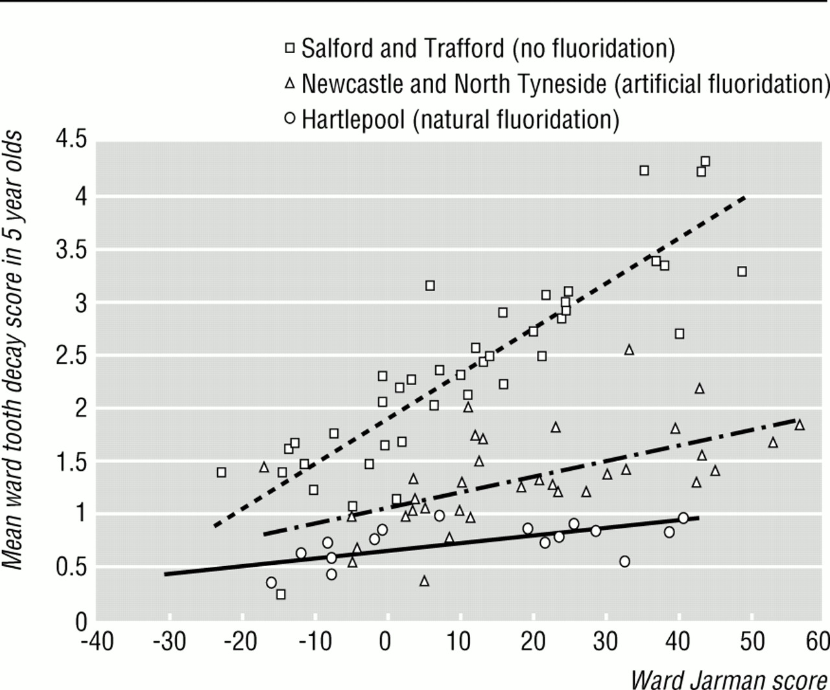
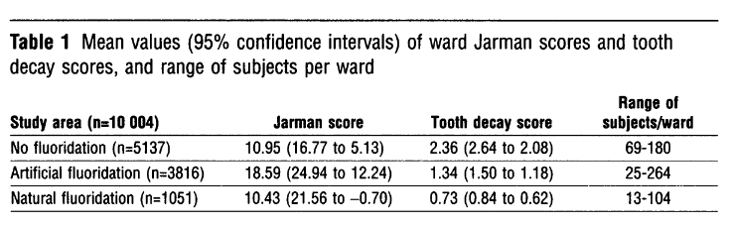
Tooth decay versus social deprivation
NHS dental surveys in 5 years old
1991 census – electoral wards in Hartlepool,
Newcastle and North Tyneside (Fluoridated),
and Salford, Trafford (Non)
N=10,004 children
Ward tooth decay vs Jarman score
(underprivileged area score)
Larger the score more deprived the area
Much beneficial for the socially deprived group

Slide 20
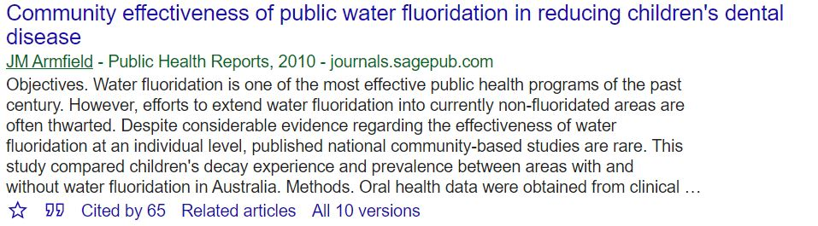
Community based study in Australia, 2002
N=128,990 (5 to 15-year-old children)
Children attending for a regular visit in 2002
Compared children’s decay experience and prevalence between areas with and without water fluoridation in Australia.

Slide 21
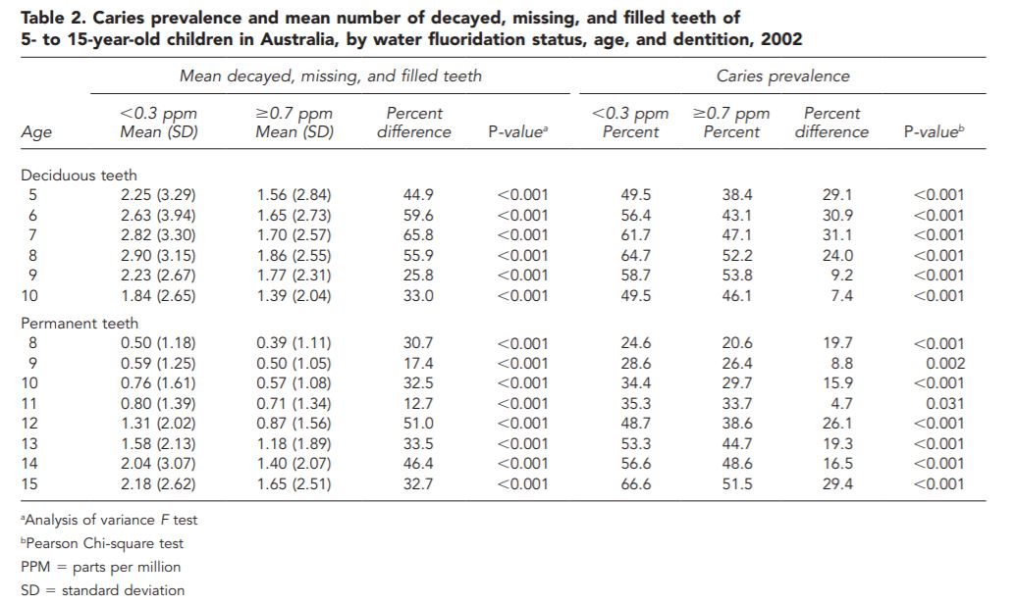











Slide 22
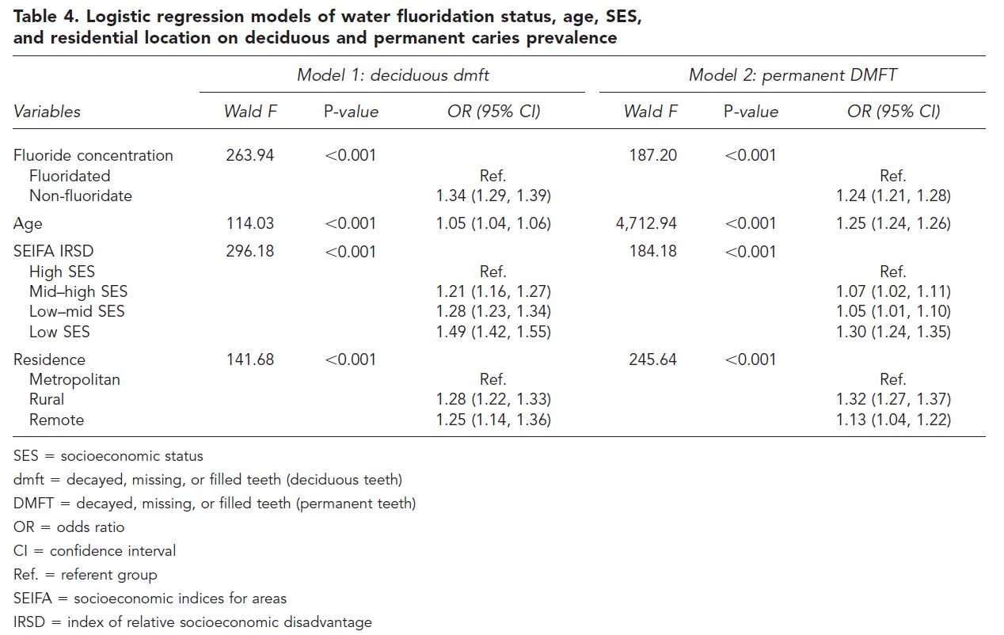

Slide 23
Findings against fluoridation

Slide 24
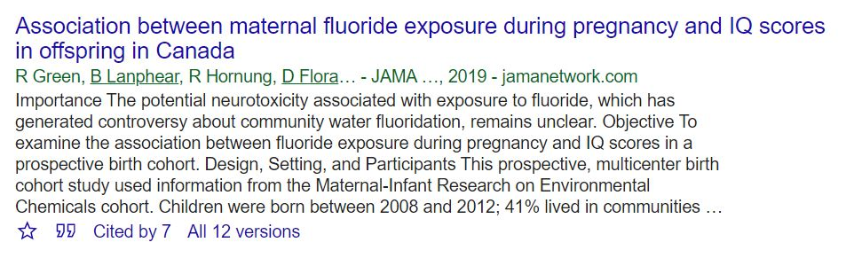
Child’s IQ versus Fluoridation in pregnancy, Canada 2019
prospective, multicenter birth cohort study based on six cities in Canada (Vancouver, Montreal, Kingston, Toronto, Hamilton, and Halifax)
aim is to examine the association between fluoride exposure during pregnancy and IQ scores of the child.
Exposures: Maternal urinary fluoride (MUFSG) and self-reported maternal daily fluoride intake; Outcome: Children’s IQ

Slide 25
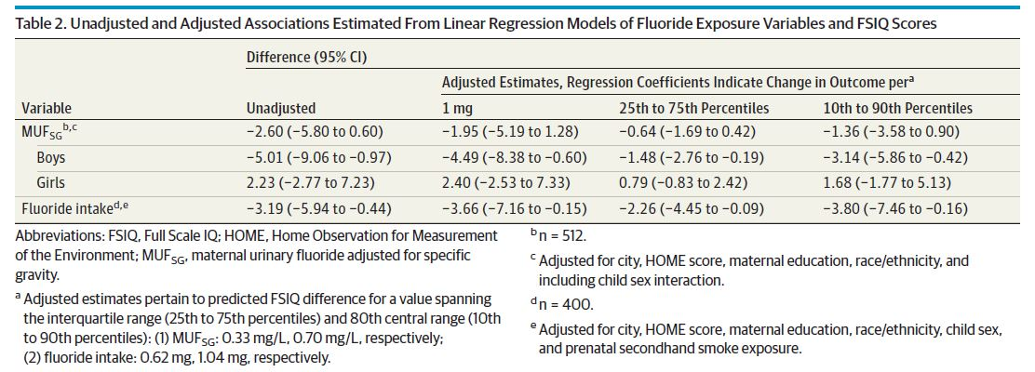

Slide 26
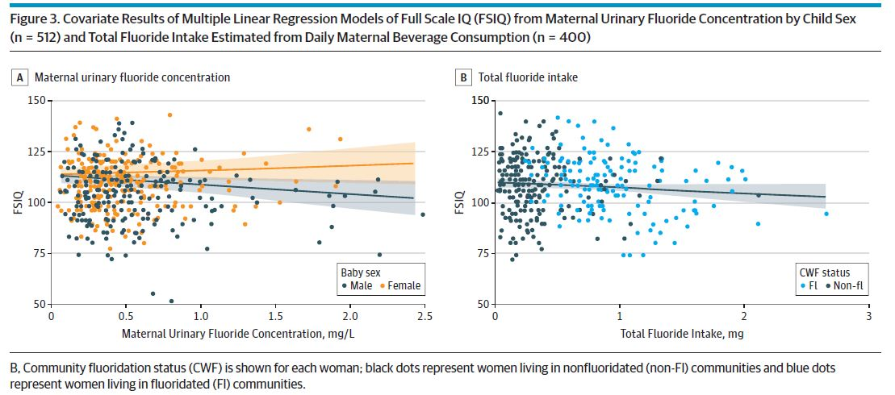

Slide 27
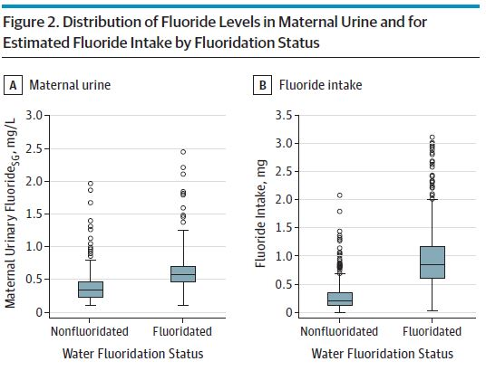
Flaws of the research
nearly everyone in the study had a fluoride intake of less than 2 mg/L (safe dose)
a lot of variation in the data -which makes drawing firm conclusions/predictions difficult
self-reported fluoride intake used in the analysis (a concern for measurement error)
below 2mg/L

Slide 28
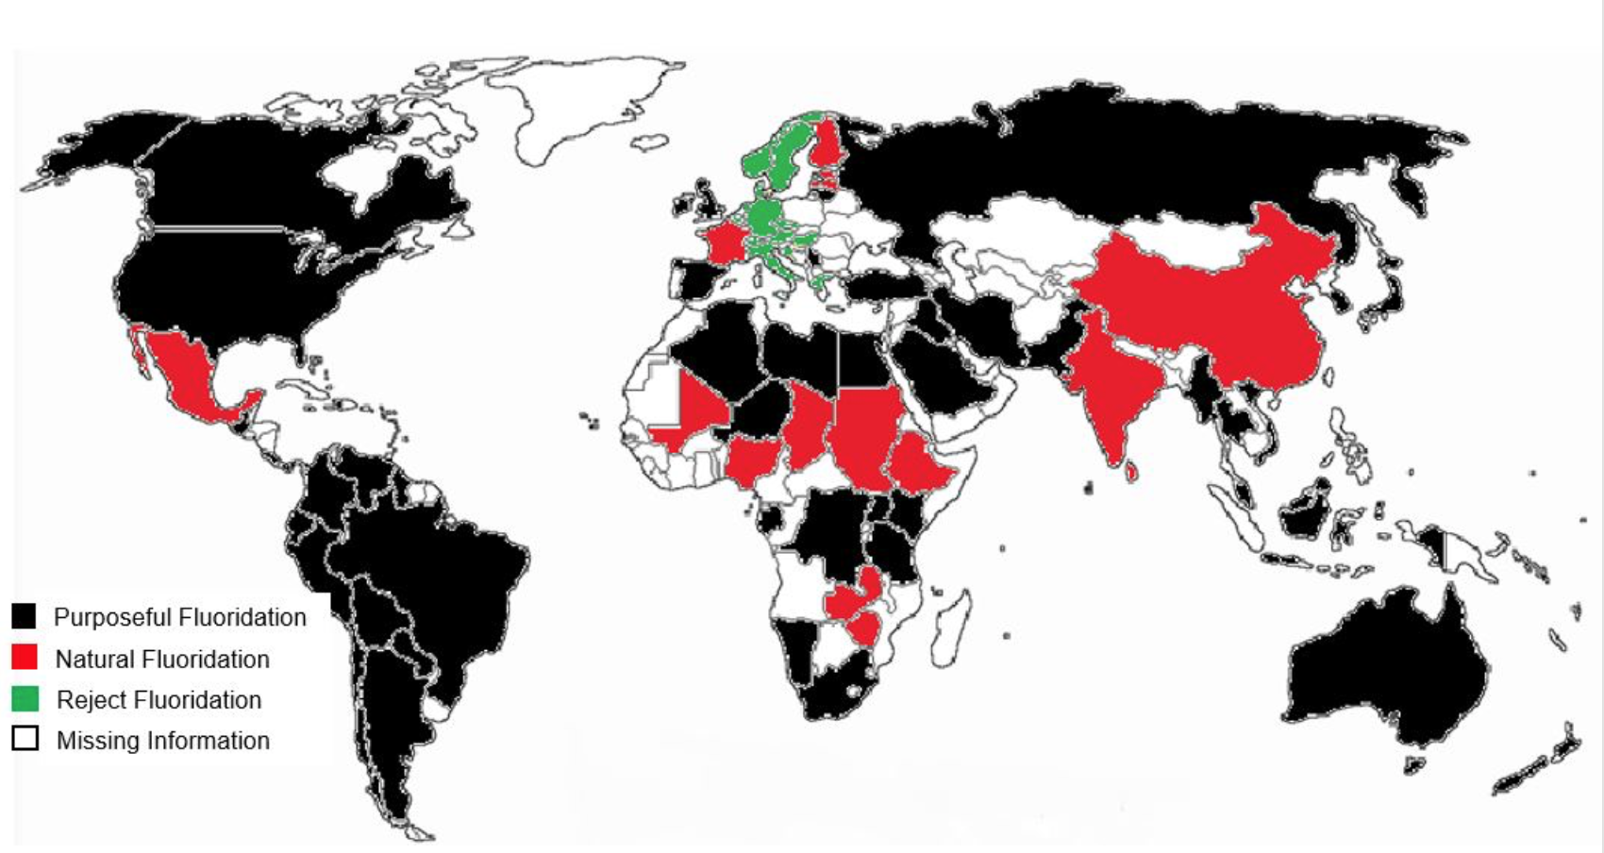
World fluoridation (2017)

Slide 29
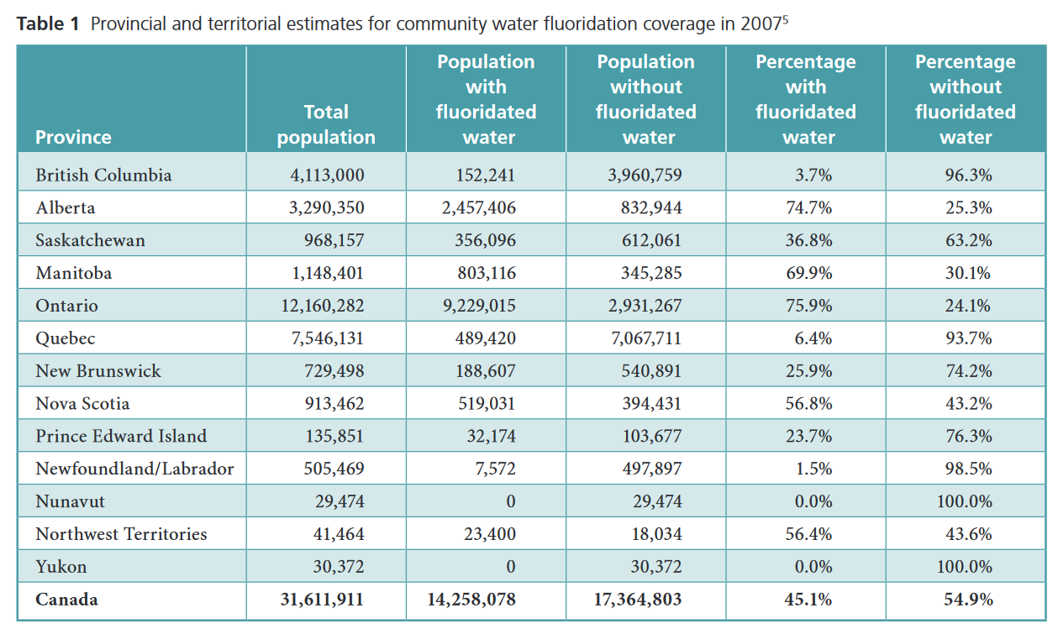
Water fluoridation in Canada

Slide 30

Debate…
Fluoridation versus No-fluoridation

Slide 31

Hopeful…
The Center for Disease Control and Prevention (CDC) named community water fluoridation one of the 10 great public health achievements of the 20th century.
The World Health Organization (WHO) considers access to fluoride to be a part of the basic human right to life.

Slide 32
References
Armfield, J. M. (2010). Community effectiveness of public water fluoridation in reducing children's dental disease. Public Health Reports, 125(5), 655-664.
Centers for Disease Control and Prevention. Ten great public health achievements – United States, 1900-1999. MMWR Weekly. 1999;48(12). Available: www.cdc.gov/mmwr/preview/mmwrhtml/00056796.htm.
Green, R., Lanphear, B., Hornung, R., Flora, D., Martinez-Mier, E. A., Neufeld, R., ... & Till, C. (2019). Association between maternal fluoride exposure during pregnancy and IQ scores in offspring in Canada. JAMA pediatrics, 173(10), 940-948.
Jones, C. M., Taylor, G. O., Whittle, J. G., Evans, D., & Trotter, D. P. (1997). Water fluoridation, tooth decay in 5 year olds, and social deprivation measured by the Jarman score: analysis of data from British dental surveys. BMJ, 315(7107), 514-517.

Slide 33
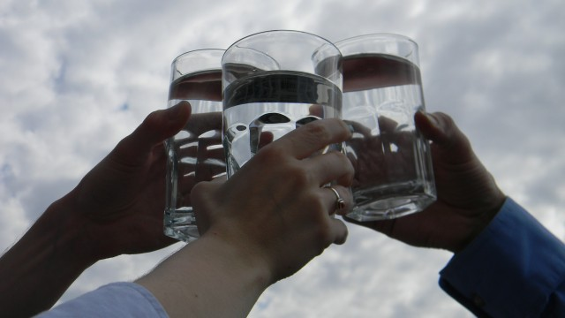
Thank you!

